Slide 1
Math. for CS
Ch 6- State Machines
Prof. Shunxiang Zhang
Anhui University of Science & Technology
Computer Science and Engineering
Mobile Phone：189-6377-7827
Email：sxzh666@gmail.com;sxzhang@aust.edu.cn

Slide 2
Topics covered/Contents
6.1 States and Transitions
6.2 The Invariant Principle
6.3 Partial Correctness & Termination
6.4 The Stable Marriage Problem

Slide 3
Ch 6- State Machines
State machines are a simple, abstract model of step-by-step processes. Since computer programs can be understood as defining step-by-step computational processes, it’s not surprising that state machines come up regularly in computer science. They also come up in many other settings such as designing digital circuits and modeling probabilistic processes. This section introduces Floyd’s Invariant Principle which is a version of induction tailored specifically for proving properties of state
machines.

Slide 4
Ch 6- State Machines
One of the most important uses of induction in computer science involves proving one or more desirable properties continues to hold at every step in a process. A property that is preserved through a series of operations or steps is known as a preserved invariant.
Examples of desirable invariants include properties such as a variable never exceeding a certain value, the altitude of a plane never dropping below 1,000 feet without the wingflaps being deployed, and the temperature of a nuclear reactor never exceeding the threshold for a meltdown.

Slide 5
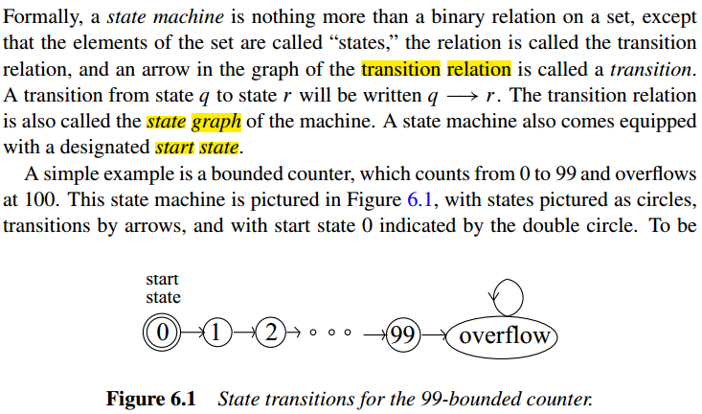
6.1 States and Transitions

Slide 6
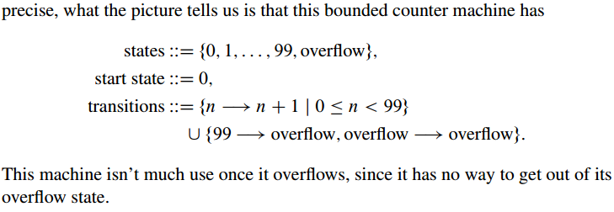
6.1 States and Transitions

Slide 7
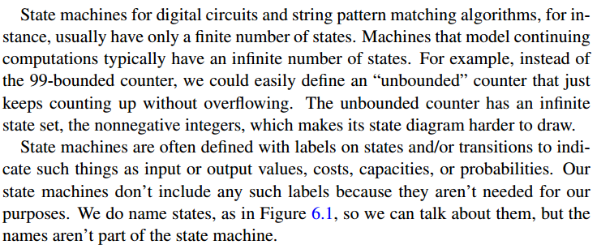
6.1 States and Transitions

Slide 8
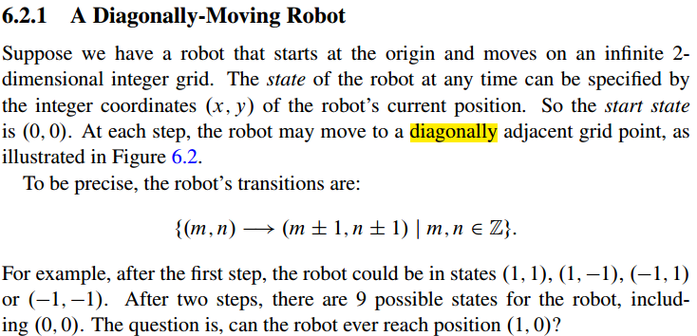
6.2 The Invariant Principle

Slide 9
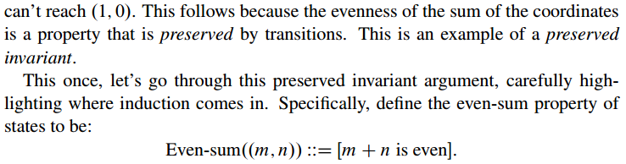
6.2 The Invariant Principle

Slide 10
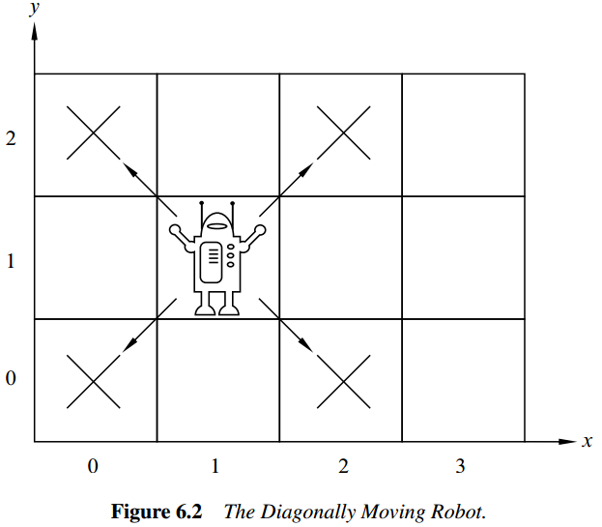
6.2 The Invariant Principle

Slide 11
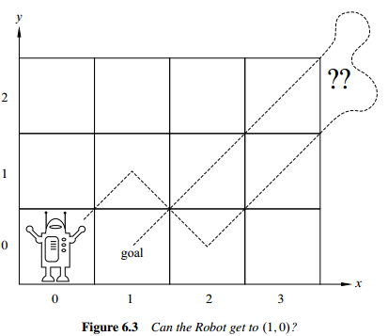
6.2 The Invariant Principle

Slide 12
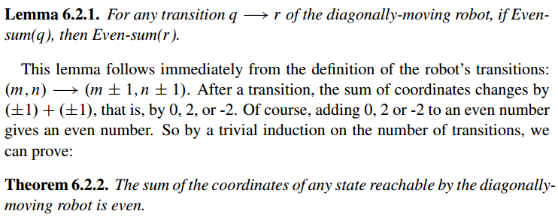
6.2 The Invariant Principle

Slide 13
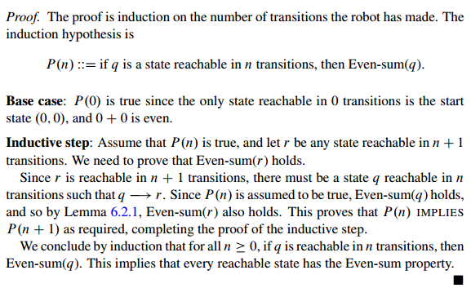
6.2 The Invariant Principle

Slide 14
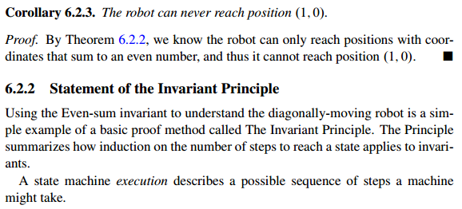
6.2 The Invariant Principle

Slide 15
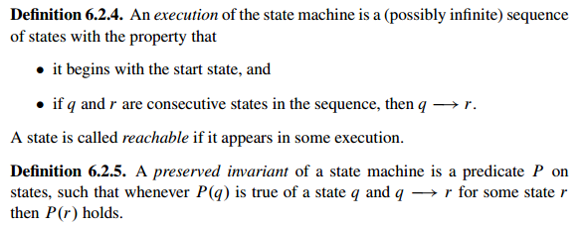
6.2 The Invariant Principle

Slide 16
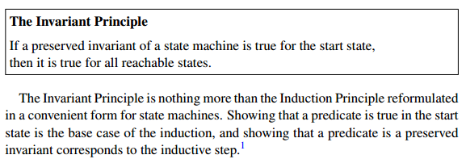
6.2 The Invariant Principle

Slide 17
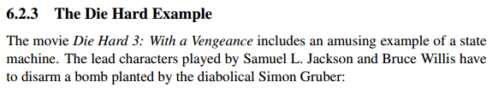
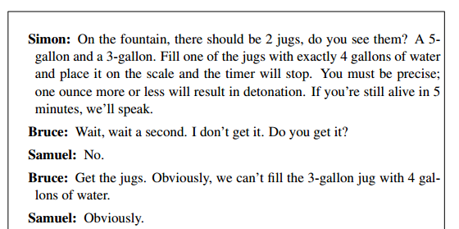
6.2 The Invariant Principle

Slide 18
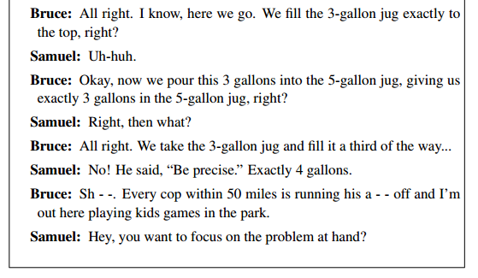
6.2 The Invariant Principle

Slide 19
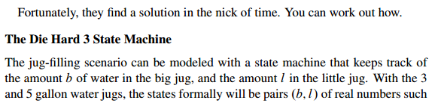

6.2 The Invariant Principle

Slide 20
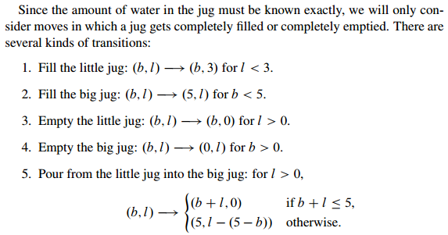
6.2 The Invariant Principle

Slide 21
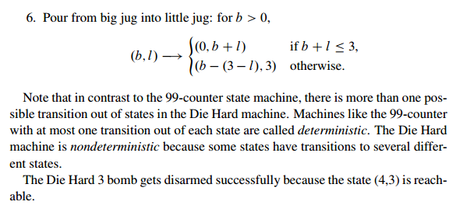
6.2 The Invariant Principle

Slide 22
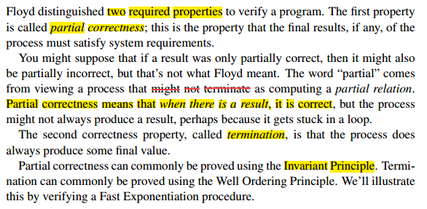
6.3 Partial Correctness & Termination

Slide 23
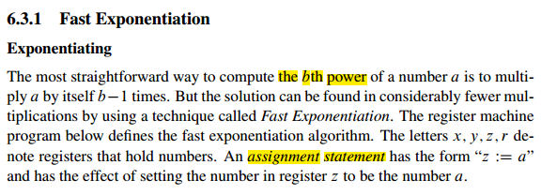
6.3 Partial Correctness & Termination

Slide 24
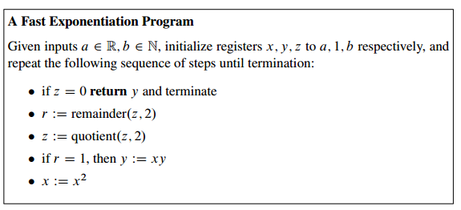
6.3 Partial Correctness & Termination

Slide 25
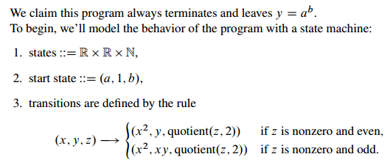
6.3 Partial Correctness & Termination

Slide 26
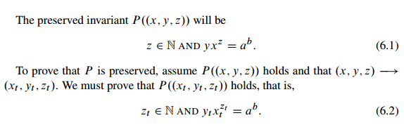
6.3 Partial Correctness & Termination

Slide 27
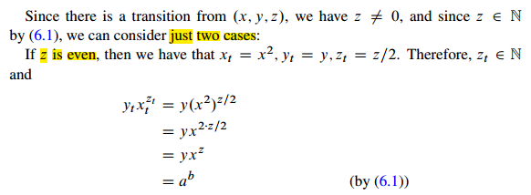
6.3 Partial Correctness & Termination

Slide 28
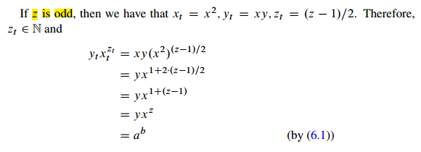
6.3 Partial Correctness & Termination

Slide 29
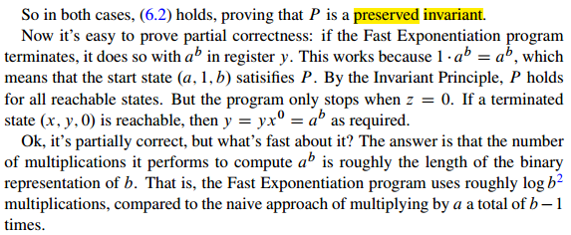
6.3 Partial Correctness & Termination

Slide 30
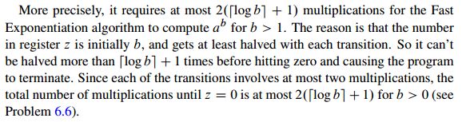
6.3 Partial Correctness & Termination

Slide 31
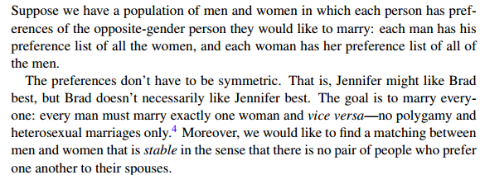
6.4 The Stable Marriage Problem

Slide 32
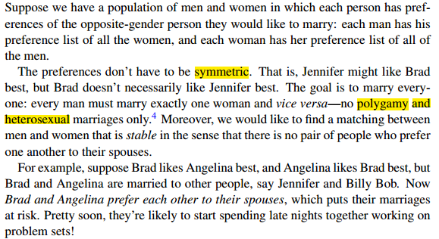
6.4 The Stable Marriage Problem

Slide 33

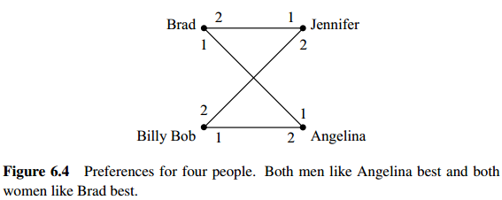
6.4 The Stable Marriage Problem

Slide 34
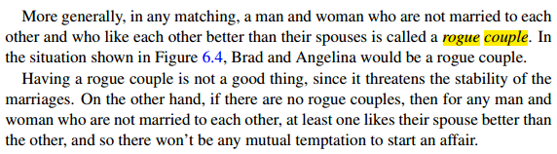
6.4 The Stable Marriage Problem

Slide 35
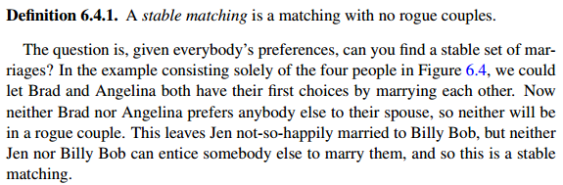
6.4 The Stable Marriage Problem

Slide 36
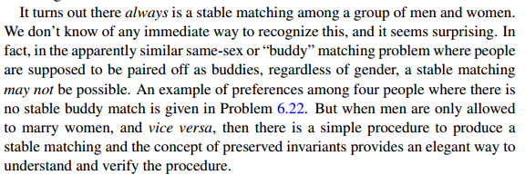
6.4 The Stable Marriage Problem

Slide 37
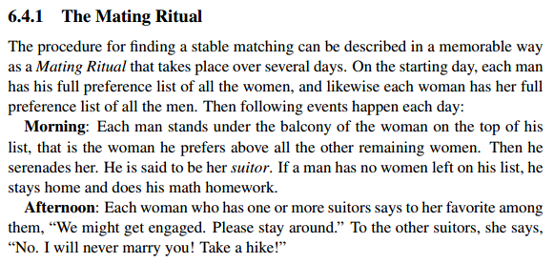
6.4 The Stable Marriage Problem

Slide 38
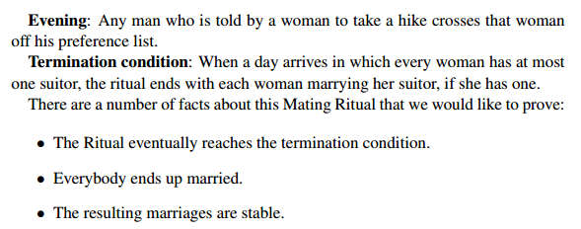
6.4 The Stable Marriage Problem

Slide 39
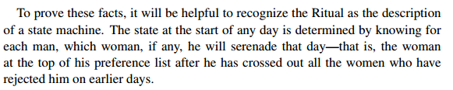
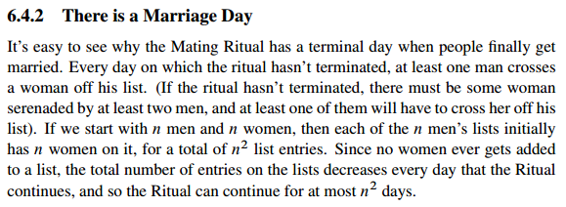
6.4 The Stable Marriage Problem

Slide 40
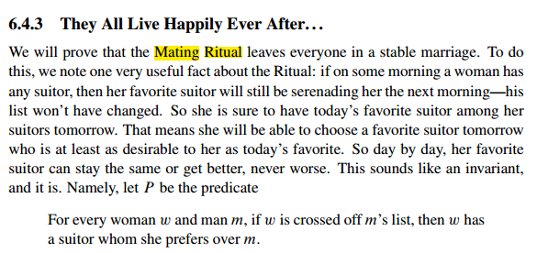
6.4 The Stable Marriage Problem

Slide 41
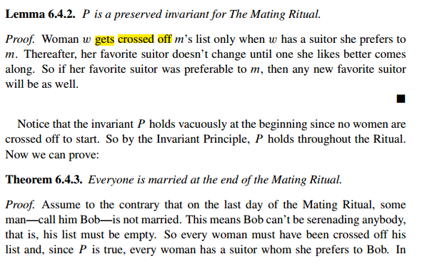
6.4 The Stable Marriage Problem

Slide 42
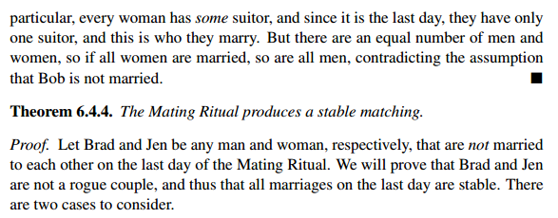
6.4 The Stable Marriage Problem

Slide 43
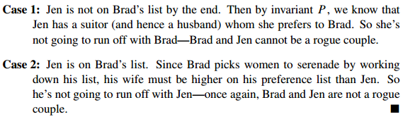
6.4 The Stable Marriage Problem

Slide 44

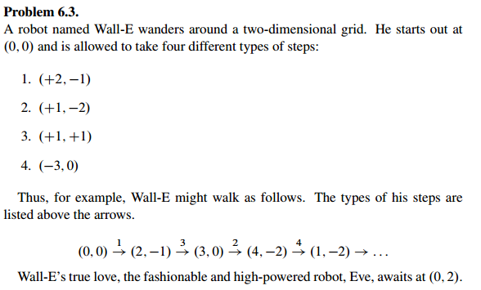

6.5 Group/Panel discussion
Group 1

Slide 45
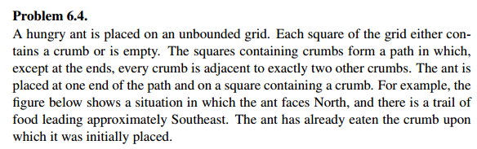
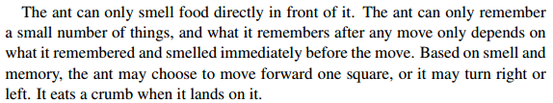
6.5 Group/Panel discussion
Group 1

Slide 46
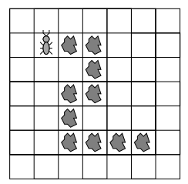
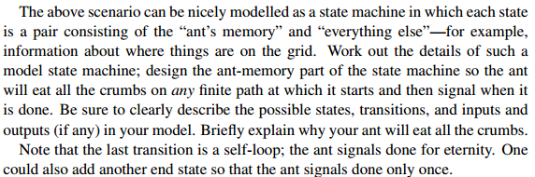
6.5 Group/Panel discussion
Group 1

